Slide 1
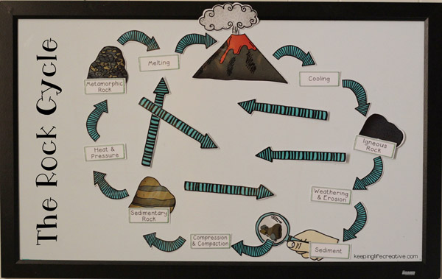
Rock Cycle Poster – Research Day
Your task today is to appropriately use the chrome books to research rocks and the rock cycle
Use the internet to research types of rocks, processes and terminology.
Don’t limit yourself to just the basic information. Dig a bit deeper – for example find out specific types of each rock type
You will use all of this information to create your own poster of the rock cycle that will include pictures and illustrations.
Use the sheets provided to guide your research.
Tips…
Be sure to use more than one site this way you can double check your research
If you find specific examples / pictures you want to use on your poster save them. They can be printed in color and used on the poster itself
If you find interesting facts save them – they can also be added to your poster.
DO NOT – copy text from websites word for word – this will get you a zero.

